Slide 1
Institutional Buy-In
WZDx Technical Assistance Subgroup – Fall 2021

Slide 2
Why commit to WZDx?
The world of transportation is shifting toward Connected and Autonomous Vehicles (CAVs).
One of the largest roadblocks that manufacturers face today in deploying CAV systems is the safe navigation through work zones. Being able to identify and safely navigate work zones is critical for CAVs to operate on our roadways.
While some existing technologies can identify work zones in a general sense, additional descriptive details and knowledge of worker presence in those zones will enable better awareness within CAVs.
“WYDOT has now committed to fundamentally shifting the accuracy and timeliness of our Work Zone data in order to ensure drivers get the best available information.” – Vince Garcia, WYDOT

Slide 3
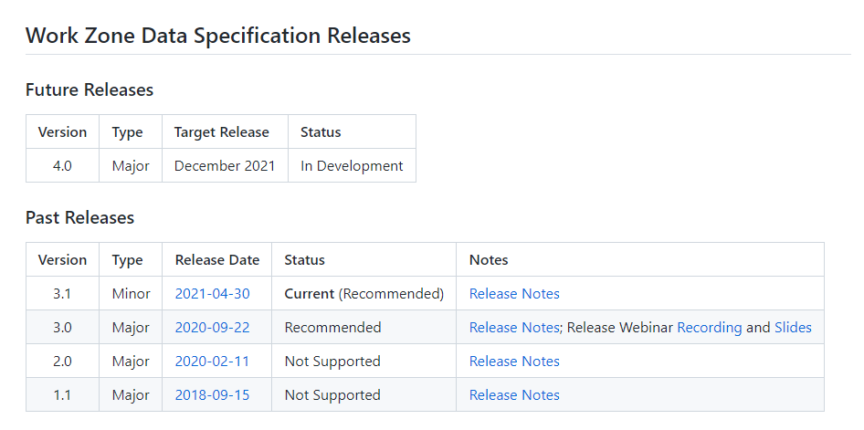
Specification Updates
Why should I adopt the spec now, while it is still undergoing development?
Current specification is relatively stable, and most updates are being made to clean up confusing, redundant, or unused fields.
The Spec Update Subgroup plans to maintain a cycle of two updates per year. Updates will prioritize backwards compatibility (minor release) and will break backwards compatibility at most once per year (major release).
A guide to assist with the transition from one version of the spec to another is being drafted.
Check GitHub for the list of currently recommended versions.
Any data is better than nothing! Older versions of the spec can still be used.

Slide 4
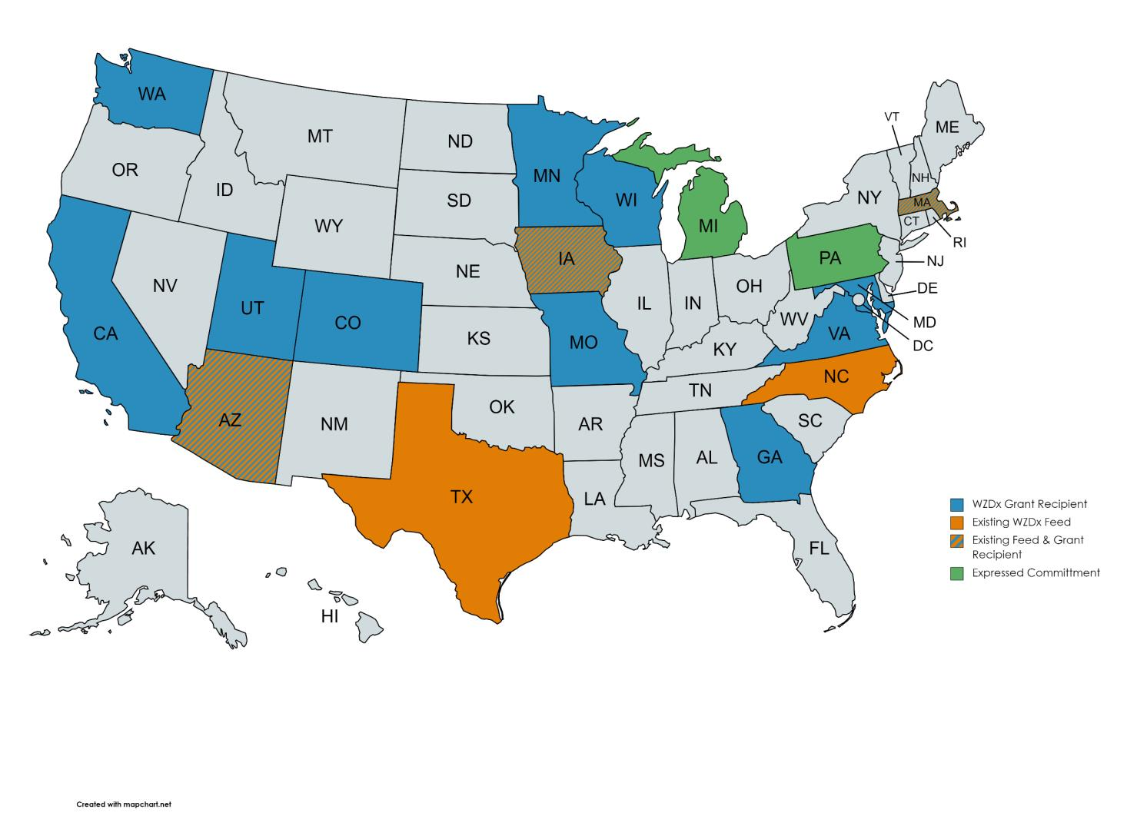
Map of WZDx Activity
Environmental Benefits, Worker Safety & Driver Safety
Accuracy:
One centralized location for WZ feeds.
Messages to drivers created from WZDx data will be based on most accurate information available.
Time Savings:
Data is input one time in one place thus reducing the need for forms and numerous additions/changes to work zone data.
Standardization/Consistency:
A standard defined data set offers the ability to build applications on top of the data. Knowing that the data will have a consistent format brings confidence in the investment to develop new tools/applications.

